Slide 1
CSE 440
Artificial Intelligence
Constraint Satisfaction Problems
Dr. Mohammad Mahmudul Alam
Department of Electrical & Computer Engineering (ECE)
North South University (NSU)

Slide 2
Last Time
A multi-agent environment has conflicting goals that give rise to Adversarial search.
In a two-player game, the decision made by one agent affects the resulting search space the other agent needs to explore.
We apply the minimax search algorithm that finds the optimal move leading to a terminal state with maximum utility.
For exponential game states, the Alpha-Beta pruning algorithm reduces the effective branching factor.
It maintains variables α and β to cut off the search when a value is out of bound.

Slide 3
Constraint Satisfaction Problems
Standard search problem:
We solve by searching state space: a graph where the nodes are states and edges between them are actions.
Each state is atomic, a “black box” – any data structure that supports successor function, heuristic function, and goal test.
CSP:
In CSP, we open the “black box” and represent each state with a set of variables, values, constraints.
A problem is solved when each variable has a value that satisfies all the constraints on the variable.
A problem described this way is called a constraint satisfaction problem (CSP).

Slide 4
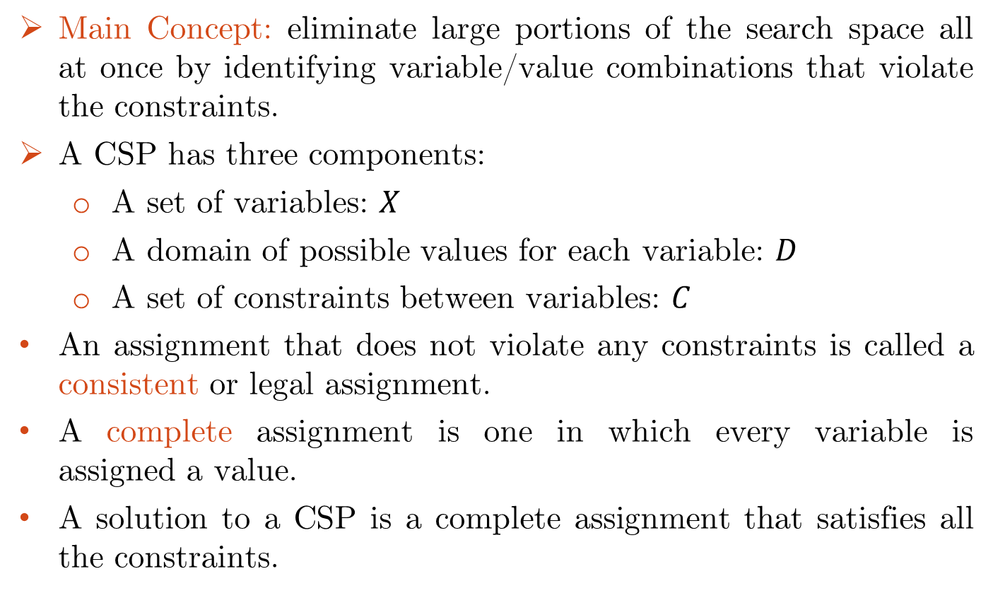


Constraint Satisfaction Problems
Main Concept: eliminate large portions of the search space all at once by identifying variable/value combinations that violate the constraints.
A CSP has three components:
  A set of variables: $X$
  A domain of possible values for each variable: $D$
  A set of constraints between variables: $C$
An assignment that does not violate any constraints is called a consistent or legal assignment.
A complete assignment is one in which every variable is assigned a value.
A solution to a CSP is a complete assignment that satisfies all the constraints.

Slide 5
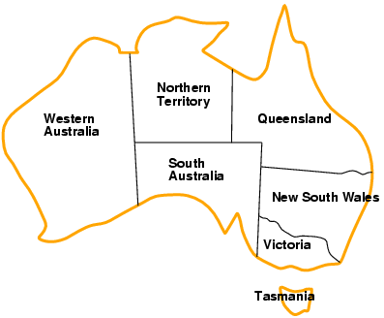
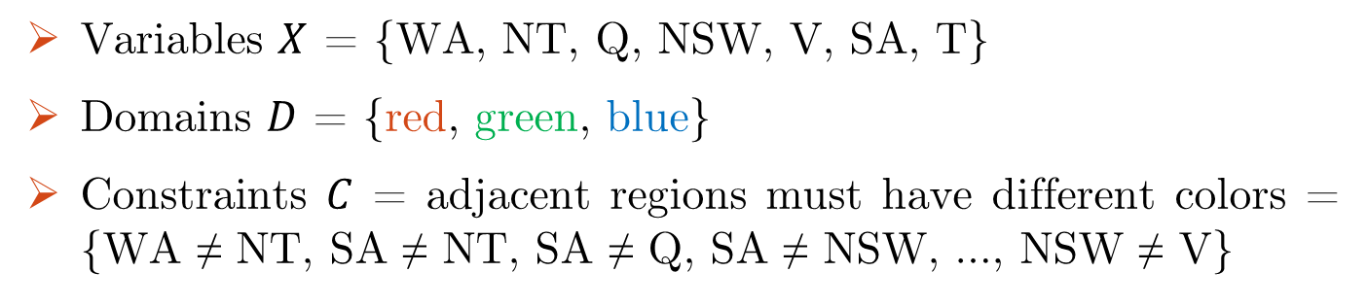
Example: Map Coloring
Variables $X$ = {WA, NT, Q, NSW, V, SA, T}
Domains $D$ = {red, green, blue}
Constraints $C$ = adjacent regions must have different colors = {WA ≠ NT, SA ≠ NT, SA ≠ Q, SA ≠ NSW, …, NSW ≠ V}

Slide 6
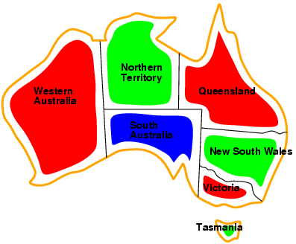
Example: Map Coloring
Solutions are complete and consistent assignments, e.g.,
{WA = red, NT = green, Q = red, NSW = green, V = red, SA = blue, T = green}
A state may be incomplete, e.g., just WA=red

Slide 7
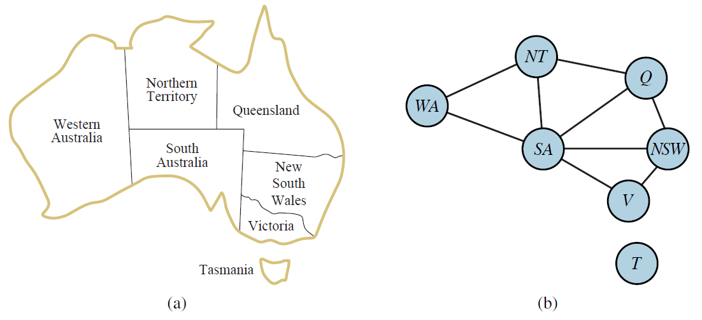
Constraint Graph
It is helpful to visualize a CSP as a constraint graph.
Constraint graph: nodes are variables, arcs are constraints.
Binary CSP: each constraint relates two variables.
Notes:
Here each link relates two nodes i.e. variables
Binary constraints involve pairs of variables e.g. SA ≠ WA

Slide 8
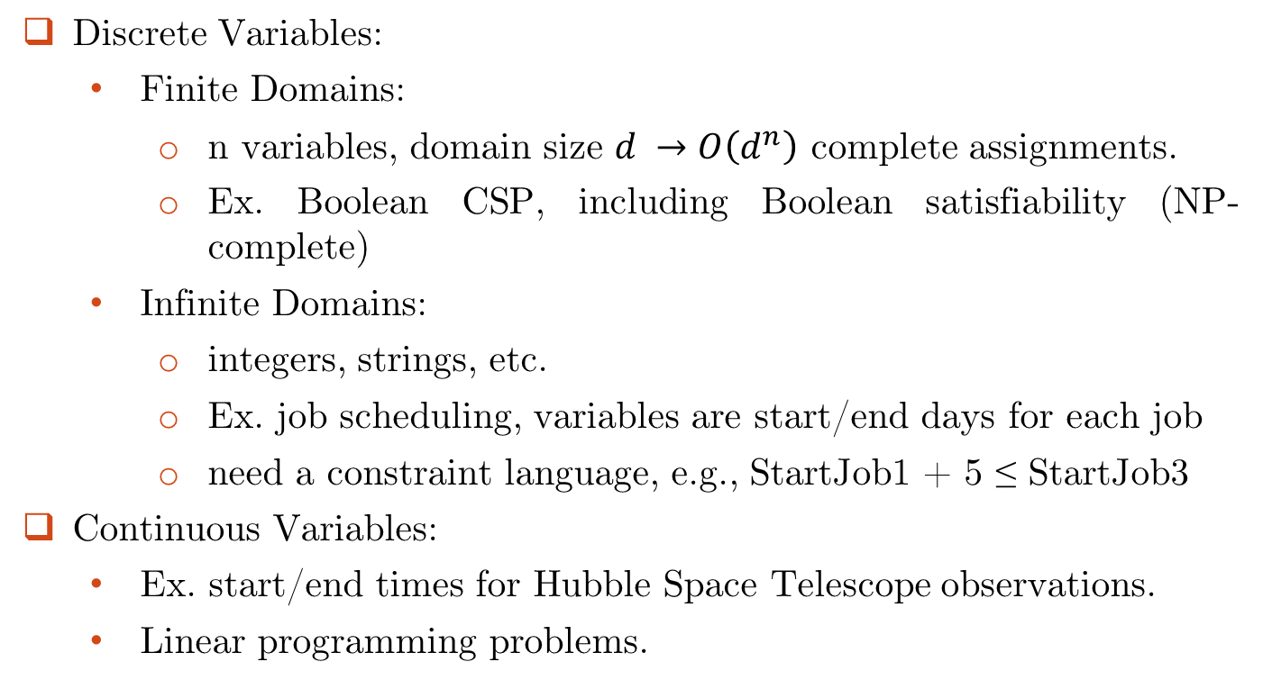
Variations of CSP
Discrete Variables:
  Finite Domains:
    n variables, domain size $d →O\left(d^{n}\right)$ complete assignments.
    Ex. Boolean CSP, including Boolean satisfiability (NP-complete)
  Infinite Domains:
    integers, strings, etc.
    Ex. job scheduling, variables are start/end days for each job
    need a constraint language, e.g., StartJob1 + 5 ≤ StartJob3
Continuous Variables:
  Ex. start/end times for Hubble Space Telescope observations.
  Linear programming problems.

Slide 9
Variations of CSP
Unary constraints involve a single variable,
  e.g., SA ≠ green
Binary constraints involve pairs of variables,
  e.g., SA ≠ WA
Higher-order constraints involve 3 or more variables,
  e.g., cryptarithmetic column constraints

Slide 10
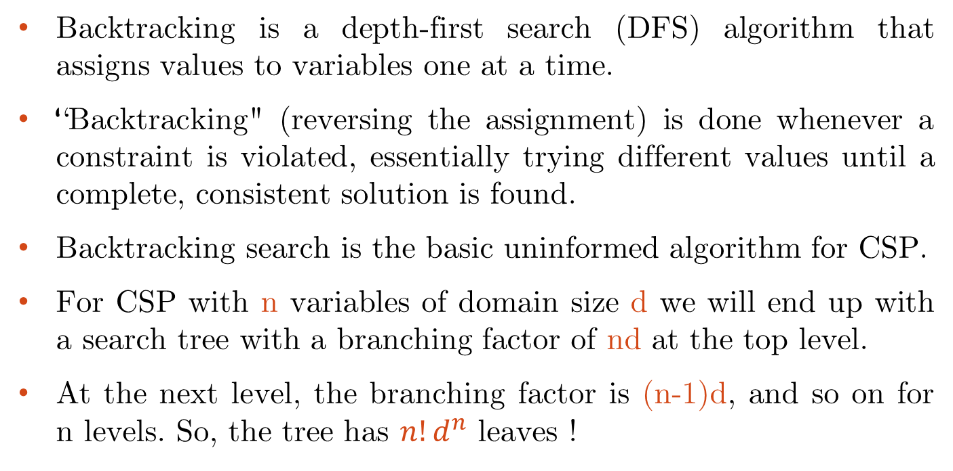
Backtracking Search for CSP
Backtracking is a depth-first search (DFS) algorithm that assigns values to variables one at a time.
“Backtracking" (reversing the assignment) is done whenever a constraint is violated, essentially trying different values until a complete, consistent solution is found.
Backtracking search is the basic uninformed algorithm for CSP.
For CSP with n variables of domain size d we will end up with a search tree with a branching factor of nd at the top level.
At the next level, the branching factor is (n-1)d, and so on for n levels. So, the tree has $n!d^{n}$ leaves !

Slide 11
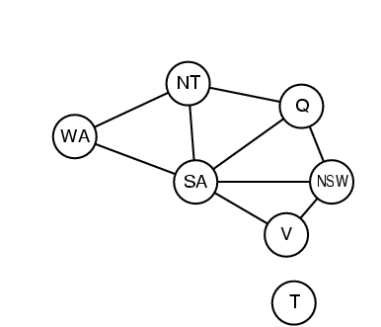
Search Formulation
Let’s try the standard search formulation. We need:
Initial state: none of the variables has a value (color)
Successor state: one of the variables is assigned a value.
Goal: all variables have a value without any constraint violation.
N layers
NxD
WA
WA
WA
NT
T
[NxD]x[(N-1)xD]
WA
NT
WA
NT
WA
NT
NT
WA
N! x D^{N}
Equal!
There are N! x D^{N} nodes in the tree but only D^{N} distinct states??

Slide 12
Backtracking Search
Special property of CSPs: They are commutative. This means: the order in which we assign variables does not matter.
Better search tree: First order variables, then assign them values one-by-one.
NT
WA
=
WA
NT
D
D²
WA
WA
WA
WA
NT
WA
NT
WA
NT
D^{N}

Slide 13
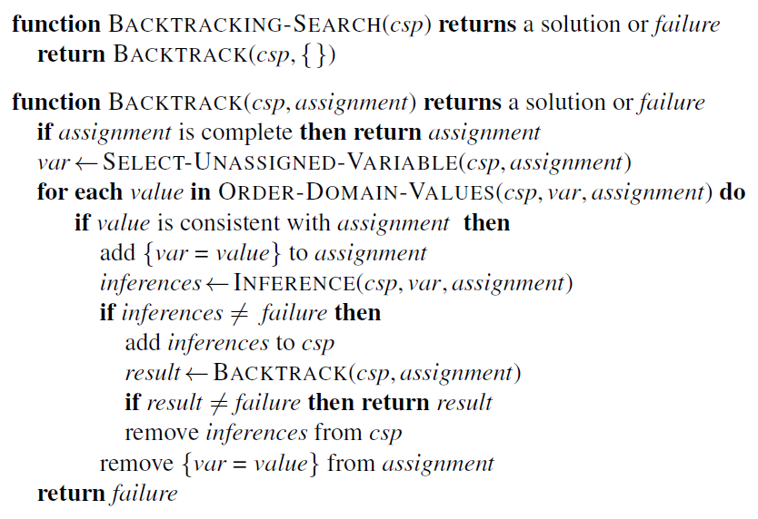
Backtracking Search

Slide 14

Backtracking Search

Slide 15
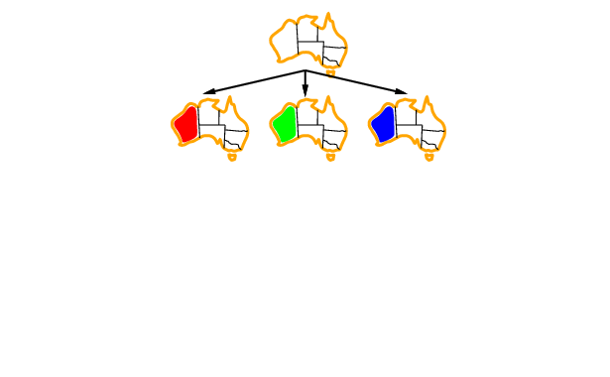
Backtracking Search

Slide 16
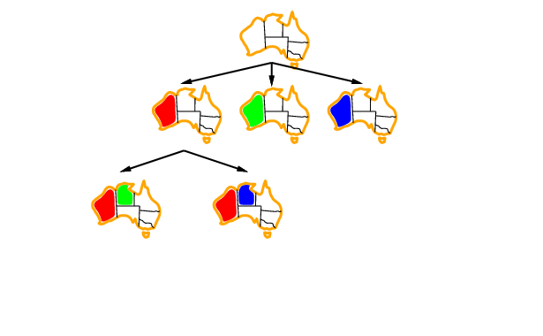
Backtracking Search

Slide 17
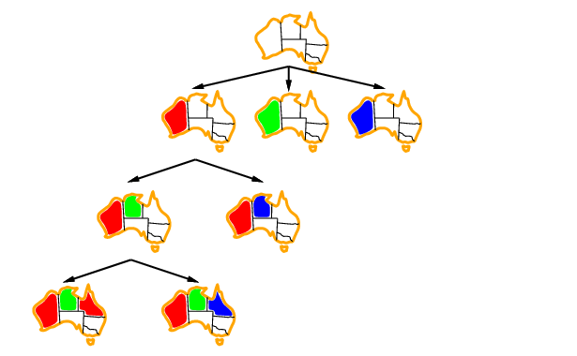
Backtracking Search

Slide 18
Depth First Search: Review
Application: Given the following state space (tree search), give the sequence of visited nodes when using DFS (assume that the node O is the goal state):
A
B
C
D
E
F
G
H
I
J
K
L
M
N
O

Slide 19
Depth First Search: Review
A,
A
B
C
D
E

Slide 20
Depth First Search: Review
A,B,
A
B
C
D
E
F
G

Slide 21
Depth First Search: Review
A,B,F,
A
B
C
D
E
F
G

Slide 22
Depth First Search: Review
A,B,F,
G,
A
B
C
D
E
F
G
K
L

Slide 23
Depth First Search: Review
A,B,F,
G,K,
A
B
C
D
E
F
G
K
L

Slide 24
Depth First Search: Review
A,B,F,
G,K,
L,
A
B
C
D
E
F
G
K
L
O

Slide 25
Depth First Search: Review
A,B,F,
G,K,
L, O: Goal State
A
B
C
D
E
F
G
K
L
O

Slide 26
Depth First Search: Review
The returned solution is the sequence of operators in the path: A, B, G, L, O : assignments when using CSP !!!
A
B
C
D
E
F
G
K
L
O

Slide 27
Backtracking Search: Example
A
B
E
C
D
H
F
G
color me!

Slide 28
Backtracking Search: Example
{blue, green, red}
{blue, green, red}
A
B
{blue, green, red}
E
C
{blue, green, red}
D
{blue, green, red}
H
{blue, green, red}
F
G
{blue, green, red}
{blue, green, red}

Slide 29
Backtracking Search: Example
A
B
E
C
D
H
F
G

Slide 30





Backtracking Search: Example
A
B
E
C
D
H
F
G

Slide 31
Backtracking Search: Example
A
B
E
C
D
H
F
G

Slide 32
Backtracking Search: Example
A
B
E
C
D
H
F
G

Slide 33
Backtracking Search: Example
A
B
E
C
D
H
F
G

Slide 34
Backtracking Search: Example
A
B
E
C
D
H
F
G

Slide 35
Backtracking Search: Example
A
B
E
C
D
H
F
G
Dead end → backtrack

Slide 36
Backtracking Search: Example
A
B
E
C
D
H
F
G

Slide 37
Backtracking Search: Example
A
B
E
C
D
H
F
G

Slide 38
Backtracking Search: Example
A
B
E
C
D
H
F
G

Slide 39
Backtracking Search: Example
A
B
E
C
D
H
F
G

Slide 40
Backtracking Search: Example
A
B
E
C
D
H
F
G

Slide 41
Backtracking Search: Example
A
B
E
C
D
H
F
G
Solution !!!!

Slide 42
Backtracking Search: Exercise
[R,B,G]
[R,B,G]
B
C
A
[R]
D
E
[R,B,G]
[R,B,G]

Slide 43
Backtracking Search: Exercise
[R,B,G]
[R,B,G]
B
C
A
[R]
D
E
[R,B,G]
[R,B,G]

Slide 44
Backtracking Search: Exercise
[R,B,G]
[R,B,G]
B
C
A
[R]
D
E
[R,B,G]
[R,B,G]

Slide 45
Backtracking Search: Exercise
[R,B,G]
[R,B,G]
B
C
A
[R]
D
E
[R,B,G]
[R,B,G]

Slide 46
Backtracking Search: Exercise
[R,B,G]
[R,B,G]
B
C
A
[R]
D
E
[R,B,G]
[R,B,G]

Slide 47
Backtracking Search: Exercise
[R,B,G]
[R,B,G]
B
C
A
[R]
D
E
[R,B,G]
[R,B,G]
Dead End → Backtrack

Slide 48
Backtracking Search: Exercise
[R,B,G]
[R,B,G]
B
C
A
[R]
D
E
[R,B,G]
[R,B,G]

Slide 49
Backtracking Search: Exercise
[R,B,G]
[R,B,G]
B
C
A
[R]
D
E
[R,B,G]
[R,B,G]

Slide 50
Backtracking Search: Exercise
[R,B,G]
[R,B,G]
B
C
A
[R]
D
E
[R,B,G]
[R,B,G]
Solution !

Slide 51
Improving Backtracking Efficiency
General-purpose heuristics can give huge gains in speed:
  Which variable should be assigned next?
  In what order should its values be tried?
  Can we detect inevitable failure early?

Slide 52

Minimum Remaining Values (MRV)
Most constrained variable: choose the variable with the fewest legal values.
Called Minimum Remaining Values (MRV) heuristic.
“fail-first” heuristic: picks a variable which will cause failure as soon as possible, allowing the tree to be pruned.
The MRV heuristic usually performs better than a random or static ordering.

Slide 53
Backtracking with MRV
Choose the variable with the fewest legal values.

Slide 54
Backtracking with MRV
[R,B,G]
[R,B,G]
B
C
A
[R]
D
E
[R,B,G]
[R,B,G]

Slide 55
Backtracking with MRV
[R,B,G]
[R,B,G]
B
C
A
[R]
D
E
[R,B,G]
[R,B,G]

Slide 56
Backtracking with MRV
[R,B,G]
[R,B,G]
B
C
A
[R]
D
E
[R,B,G]
[R,B,G]

Slide 57
Backtracking with MRV
[R,B,G]
[R,B,G]
B
C
A
[R]
D
E
[R,B,G]
[R,B,G]
choose the variable with the fewest legal values

Slide 58
Backtracking with MRV
[R,B,G]
[R,B,G]
B
C
A
[R]
D
E
[R,B,G]
[R,B,G]
choose the variable with the fewest legal values

Slide 59
Backtracking with MRV
[R,B,G]
[R,B,G]
B
C
A
[R]
D
E
[R,B,G]
[R,B,G]
Solution !

Slide 60

Most Constraint Variable (MCV)
MRV doesn’t help in choosing the first region to color.
Most Constraining Variable: choose the variable with the most constraints on remaining variables.
Select variable that is involved in the largest number of constraints - edges in graph on other unassigned variables.
MRV heuristic is usually more powerful, but MCV can be useful as tie-breaker

Slide 61
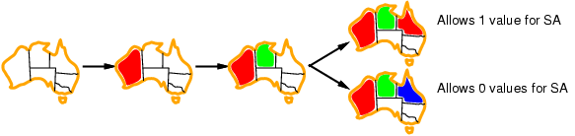
Least Constraint Variable (LCV)
Given a variable, choose the least constraining value: the one that rules out (eliminate) the fewest values in the remaining variables.

Slide 62
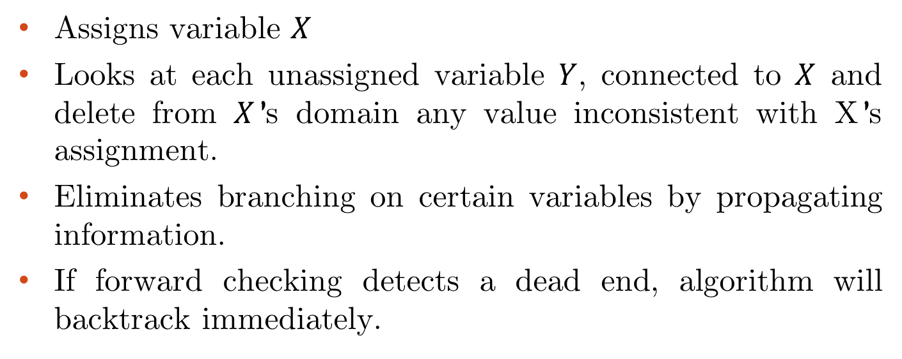
Backtracking + Forward Checking
Assigns variable $X$
Looks at each unassigned variable $Y$, connected to $X$ and delete from $X$’s domain any value inconsistent with X’s assignment.
Eliminates branching on certain variables by propagating information.
If forward checking detects a dead end, algorithm will backtrack immediately.

Slide 63
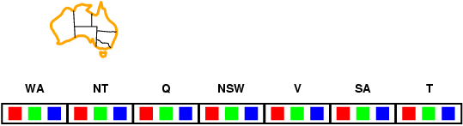
Forward Checking
Main Concept:
Keep track of remaining legal values for unassigned variables.
Terminate search when any variable has no legal values.

Slide 64
Forward Checking
WA | NT | Q | NSW | V | SA | T
RGB | RGB | RGB | RGB | RGB | RGB | RGB

Slide 65
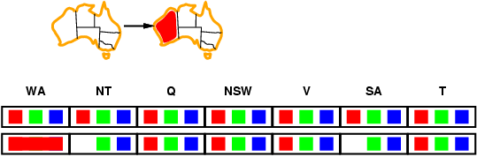
Forward Checking
WA | NT | Q | NSW | V | SA | T
RGB | RGB | RGB | RGB | RGB | RGB | RGB
R | GB | RGB | RGB | RGB | GB | RGB

Slide 66
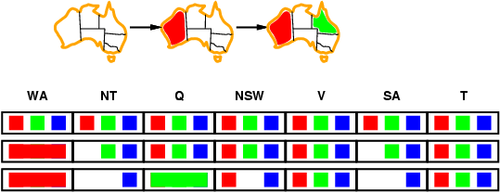
Forward Checking
WA | NT | Q | NSW | V | SA | T
RGB | RGB | RGB | RGB | RGB | RGB | RGB
R | GB | RGB | RGB | RGB | GB | RGB
R | B | G | R B | RGB | B | RGB

Slide 67
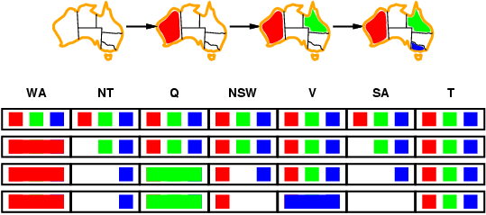
Forward Checking
WA | NT | Q | NSW | V | SA | T
RGB | RGB | RGB | RGB | RGB | RGB | RGB
R | GB | RGB | RGB | RGB | GB | RGB
R | B | G | R B | RGB | B | RGB
R | B | G | R | B |  | RGB
Dead End

Slide 68
Forward Checking: Example
X1
{1,2,3,4}
X2
{1,2,3,4}
1
2
3
4
1
2
3
4
X3
{1,2,3,4}
X4
{1,2,3,4}

Slide 69
Forward Checking: Example
X1
{1,2,3,4}
X2
{1,2,3,4}
1
2
3
4
1
2
3
4
X3
{1,2,3,4}
X4
{1,2,3,4}

Slide 70
Forward Checking: Example
X1
{1,2,3,4}
X2
{ , ,3,4}
1
2
3
4
1
2
3
4
X3
{ ,2, ,4}
X4
{ ,2,3, }

Slide 71
Forward Checking: Example
X1
{1,2,3,4}
X2
{ , ,3,4}
1
2
3
4
1
2
3
4
X3
{ ,2, ,4}
X4
{ ,2,3, }

Slide 72
Forward Checking: Example
X1
{1,2,3,4}
X2
{ , ,3,4}
1
2
3
4
1
2
3
4
X3
{ , , , }
X4
{ ,2, , }
Dead End → Backtrack

Slide 73
Forward Checking: Example
X1
{1,2,3,4}
X2
{ , , ,4}
1
2
3
4
1
2
3
4
X3
{ , 2 , , }
X4
{ , ,3, }

Slide 74
Forward Checking: Example
X1
{1,2,3,4}
X2
{ , , ,4}
1
2
3
4
1
2
3
4
X3
{ , 2 , , }
X4
{ , , , }
Dead End → Backtrack

Slide 75
Forward Checking: Example
X1
{ ,2,3,4}
X2
{1,2,3,4}
1
2
3
4
1
2
3
4
X3
{1,2,3,4}
X4
{1,2,3,4}

Slide 76
Forward Checking: Example
X1
{ ,2,3,4}
X2
{ , , ,4}
1
2
3
4
1
2
3
4
X3
{1, ,3, }
X4
{1, ,3,4}

Slide 77
Forward Checking: Example
X1
{ ,2,3,4}
X2
{ , , ,4}
1
2
3
4
1
2
3
4
X3
{1, ,3, }
X4
{1, ,3,4}

Slide 78
Example: 4-Queens Problem
X1
{ ,2,3,4}
X2
{ , , ,4}
1
2
3
4
1
2
3
4
X3
{1, , , }
X4
{1, ,3, }

Slide 79
Forward Checking: Example
X1
{ ,2,3,4}
X2
{ , , ,4}
1
2
3
4
1
2
3
4
X3
{1, , , }
X4
{1, ,3, }

Slide 80
Forward Checking: Example
X1
{ ,2,3,4}
X2
{ , , ,4}
1
2
3
4
1
2
3
4
X3
{1, , , }
X4
{ , ,3, }

Slide 81
Forward Checking: Example
X1
{ ,2,3,4}
X2
{ , , ,4}
1
2
3
4
1
2
3
4
X3
{1, , , }
X4
{ , ,3, }
Solution !

Slide 82
Forward Checking: Exercise
[R,B,G]
[R,B,G]
B
C
A
[R]
D
E
[R,B,G]
[R,B,G]

Slide 83
Forward Checking: Exercise
[ ,B,G]
[R,B,G]
B
C
A
[R]
D
E
[ ,B,G]
[R,B,G]

Slide 84
Forward Checking: Exercise
[ ,B,G]
[R,B,G]
B
C
A
[R]
D
E
[ ,B,G]
[R,B,G]

Slide 85
Forward Checking: Exercise
[ ,B,G]
[R, ,G]
B
C
A
[R]
D
E
[ , ,G]
[R, ,G]

Slide 86
Forward Checking: Exercise
[ ,B,G]
[R, ,G]
B
C
A
[R]
D
E
[ , ,G]
[R, ,G]

Slide 87
Forward Checking: Exercise
[ ,B,G]
[R, ,G]
B
C
A
[R]
D
E
[ , ,G]
[ , ,G]

Slide 88
Forward Checking: Exercise
[ ,B,G]
[R, ,G]
B
C
A
[R]
D
E
[ , ,G]
[ , ,G]

Slide 89
Forward Checking: Exercise
[ ,B,G]
[R, ,G]
B
C
A
[R]
D
E
[ , , ]
[ , ,G]
Dead End

Slide 90
Forward Checking: Exercise
[ ,B,G]
[R, ,G]
B
C
A
[R]
D
E
[ , ,G]
[R, ,G]

Slide 91
Forward Checking: Exercise
[ ,B,G]
[R, ,G]
B
C
A
[R]
D
E
[ , ,G]
[R, , ]

Slide 92
Forward Checking: Exercise
[ ,B,G]
[R, ,G]
B
C
A
[R]
D
E
[ , ,G]
[R, , ]

Slide 93
Forward Checking: Exercise
[ ,B,G]
[R, ,G]
B
C
A
[R]
D
E
[ , ,G]
[R, , ]
Solution !

Slide 94
Constraint Satisfaction Problems
Constraint Propagation
Backtracking + Arc Consistency

Slide 95
Constraint Propagation
Forward checking propagates information from assigned to unassigned variables but doesn't provide early detection for all failures.
NT and SA cannot both be blue! Constraint propagation repeatedly enforces constraints locally.

Slide 96
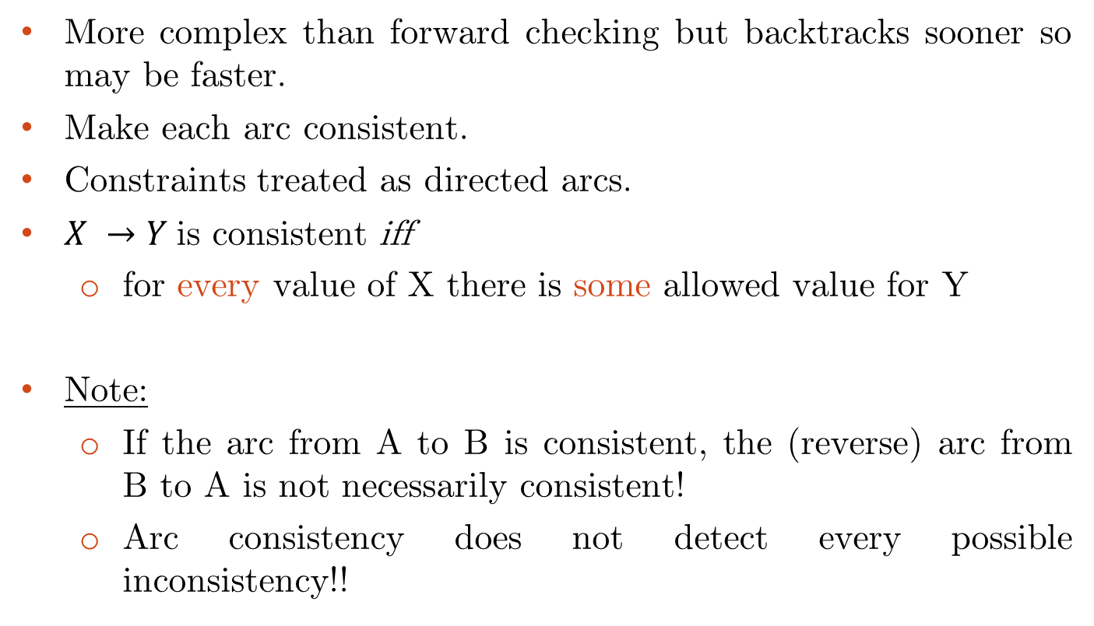
Arc Consistency
More complex than forward checking but backtracks sooner so may be faster.
Make each arc consistent.
Constraints treated as directed arcs.
$X →Y$is consistent iff
  for every value of X there is some allowed value for Y
Note:
  If the arc from A to B is consistent, the (reverse) arc from B to A is not necessarily consistent!
  Arc consistency does not detect every possible inconsistency!!

Slide 97
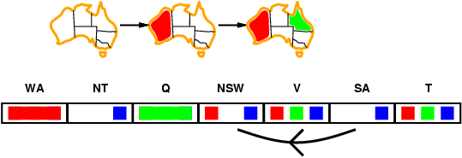

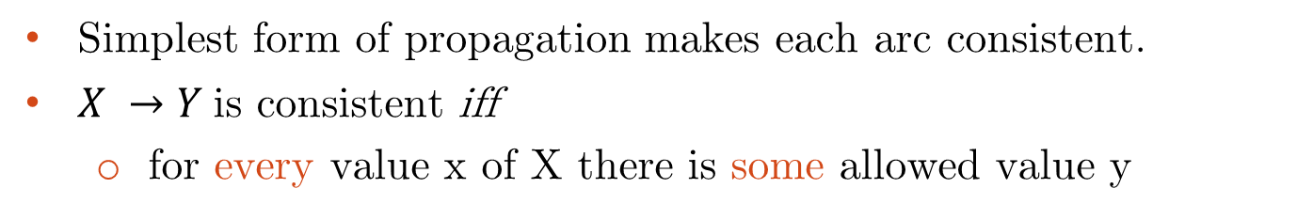
Arc Consistency
Simplest form of propagation makes each arc consistent.
$X →Y$is consistent iff
  for every value x of X there is some allowed value y

Slide 98
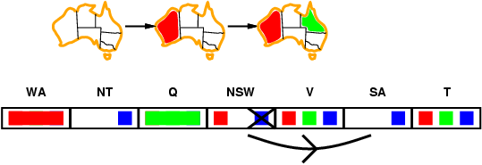
Arc Consistency
Simplest form of propagation makes each arc consistent.
$X →Y$is consistent iff
  for every value x of X there is some allowed value y

Slide 99
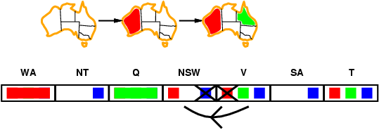
Arc Consistency
Simplest form of propagation makes each arc consistent.
$X →Y$is consistent iff
  for every value x of X there is some allowed value y
If X loses a value, neighbors of X need to be rechecked.

Slide 100
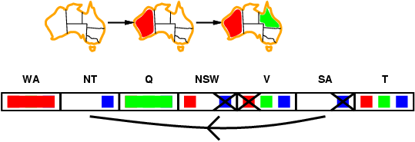
Arc Consistency
Simplest form of propagation makes each arc consistent.
$X →Y$is consistent iff
  for every value x of X there is some allowed value y
If X loses a value, neighbors of X need to be rechecked.
Arc consistency detects failure earlier than forward checking
Can be run as a preprocessor or after each assignment

Slide 101
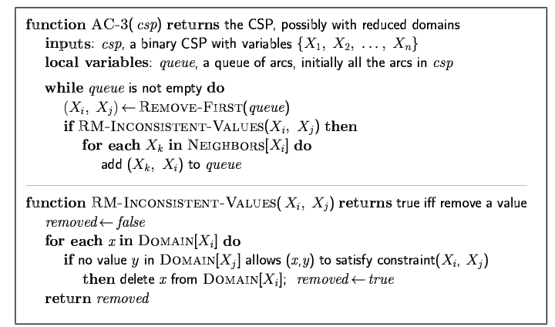

Arc Consistency Algorithm: AC-3
Time complexity: $O(n^{2}d^{3})$
Checking consistency of an arc is O(d2)

Slide 102
Arc Consistency + Backtracking
[R,B,G]
[R,B,G]
B
C
A
[R]
D
E
[R,B,G]
[R,B,G]

Slide 103
Arc Consistency + Backtracking
[ ,B,G]
[R,B,G]
B
C
A
[R]
D
E
[R,B,G]
[R,B,G]

Slide 104
Arc Consistency + Backtracking
[ ,B,G]
[R,B,G]
B
C
A
[R]
D
E
[ ,B,G]
[R,B,G]

Slide 105
Arc Consistency + Backtracking
[ ,B,G]
[R,B,G]
B
C
A
[R]
D
E
[ ,B,G]
[R,B,G]
If X loses a value, neighbors of X need to be rechecked

Slide 106
Arc Consistency + Backtracking
[ ,B,G]
[R,B,G]
B
C
A
[R]
D
E
[ ,B,G]
[R,B,G]
If X loses a value, neighbors of X need to be rechecked

Slide 107
Arc Consistency + Backtracking
[ ,B,G]
[R,B,G]
B
C
A
[R]
D
E
[ ,B,G]
[R,B,G]
If X loses a value, neighbors of X need to be rechecked

Slide 108
Arc Consistency + Backtracking
[ ,B,G]
[R,B,G]
B
C
A
[R]
D
E
[ ,B,G]
[R,B,G]

Slide 109
Arc Consistency + Backtracking
[ ,B,G]
[R,B,G]
B
C
A
[R]
D
E
[ ,B,G]
[R,B,G]

Slide 110
Arc Consistency + Backtracking
[ ,B,G]
[R,B,G]
B
C
A
[R]
D
E
[ ,B,G]
[R,B,G]

Slide 111
Arc Consistency + Backtracking
[ ,B,G]
[R, ,G]
B
C
A
[R]
D
E
[ ,B,G]
[R,B,G]

Slide 112
Arc Consistency + Backtracking
[ ,B,G]
[R, ,G]
B
C
A
[R]
D
E
[ ,B,G]
[R, ,G]

Slide 113
Arc Consistency + Backtracking
[ ,B,G]
[R, ,G]
B
C
A
[R]
D
E
[ , ,G]
[R, ,G]

Slide 114
Arc Consistency + Backtracking
[ ,B,G]
[R, ,G]
B
C
A
[R]
D
E
[ , ,G]
[R, , ]

Slide 115
Arc Consistency + Backtracking
[ ,B,G]
[ , ,G]
B
C
A
[R]
D
E
[ , ,G]
[R, , ]

Slide 116
Arc Consistency + Backtracking
[ ,B,G]
[ , ,G]
B
C
A
[R]
D
E
[ , ,G]
[R, , ]

Slide 117
Arc Consistency + Backtracking
[ ,B,G]
[ , ,G]
B
C
A
[R]
D
E
[ , ,G]
[R, , ]

Slide 118
Arc Consistency + Backtracking
[ ,B,G]
[ , ,G]
B
C
A
[R]
D
E
[ , ,G]
[R, , ]
Solution !

Slide 119
Constraint Satisfaction Problems
Local Search

Slide 120
Local Search for CSP
If the path to the solution is NOT important, we can apply local search!
Hill-climbing, simulated annealing typically work with “complete” states, i.e., all variables assigned.
To apply CSP:
  Allow states with unsatisfied constraints.
  Operators reassign variable values.
  hill-climb with value (state) = total number of violated constraints.
Variable selection:
  randomly select any conflicted variable
Value selection:
  choose value that violates the fewest constraints
  called the min-conflicts heuristic

Slide 121
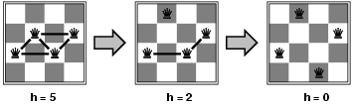
Example: 4-Queens
States: 4 queens in 4 columns (44 = 256 states)
Actions: move queen in column
Goal test: no attacks
Evaluation: h(n) = number of attacks

Slide 122
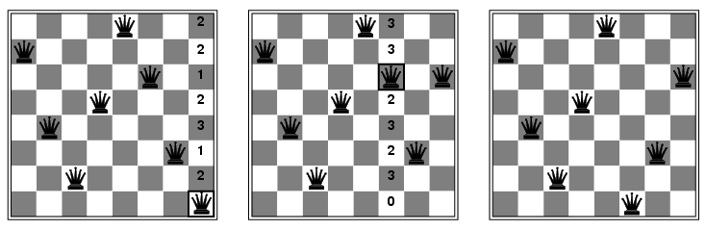
Example: 4-Queens
State:
  Variables = queens, which are confined to a column
  Value = row
Start with random state
Repeat
  Choose conflicted queen randomly
  Choose value (row) with minimal conflicts

Slide 123
Summary
CSP are a special kind of problem:
  states defined by values of a fixed set of variables.
  goal test defined by constraints on variable values.
Backtracking = Depth-First Search (DFS) with one variable assigned per node.
Variable ordering and value selection heuristics help significantly.
Forward checking prevents assignments that guarantee later failure.
Constraint propagation (e.g., arc consistency) does additional work to constrain values and detect inconsistencies.
Iterative min-conflicts is usually effective in practice.

Slide 124
Reading
Chapter 05 of the textbook
Pages: 164 - 182

